Slide 1

Breast Cancer Data Analysis Report
Prepared Using Python & Jupyter Notebook
by Ademola Abraham

Slide 2
Background & Purpose Of Analysis
The University of Calabar Teaching Hospital provided two years of breast cancer patient data to better understand diagnosis patterns, severity indicators and factors associated with malignant breast cancer cases.
Despite having patient medical records, several important clinical questions remained unanswered:
Which age groups are most affected by breast cancer?
Are larger tumor sizes more associated with malignant diagnosis?
Does menopause increase the risk of malignant breast cancer?
How strongly is metastasis connected to malignancy?
Can involved lymph nodes help predict cancer severity?
Which medical factors appear most associated with malignant diagnosis?
10 key medical questions provided by healthcare professionals were analyzed and answered through exploratory data analysis (EDA).
The goal of this analysis is to uncover medical insights that support early detection, patient risk assessment and data-driven healthcare decision-making.

Slide 3
Dataset Overview
The dataset contains breast cancer patient records collected from the University of Calabar Teaching Hospital between 2019 and 2020. The data includes patient details, tumor characteristics and diagnosis-related medical variables used for breast cancer analysis.
Dataset Summary
Dataset Type: Breast Cancer Medical Dataset
Source: University of Calabar Teaching Hospital
Study Period: 2019 – 2020
Total Records: 215 Patient Cases
Key Medical Variables
Age
Menopause Status
Medical History
Tumor Size
Metastasis
Involved Lymph Nodes
Breast Side Affected
Breast Quadrant
Diagnosis Outcome

Slide 4
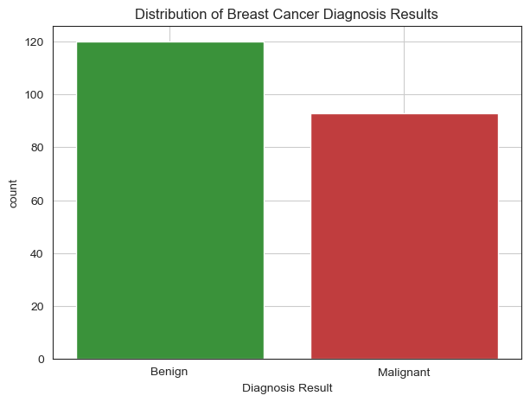
Distribution of Benign and Malignant Cancer Diagnoses
Benign cases accounted for the majority of diagnoses in the dataset with 120 recorded cases.
Malignant cases were also significantly high, with 93 recorded cases, indicating a considerable presence of severe breast cancer conditions.
The diagnosis distribution shows that while non-cancerous cases were slightly more common, malignant breast cancer remains a major health concern within the patient population.
The relatively close difference between benign and malignant cases highlights the importance of continuous screening and early detection efforts.

Slide 5
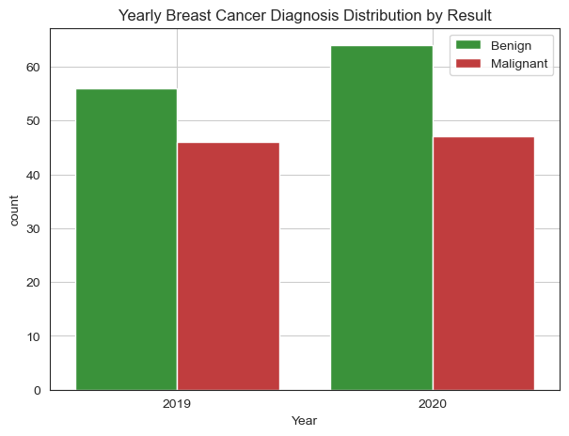
Yearly Comparison of Breast Cancer Diagnosis Cases (2019 -- 2020)
Total breast cancer cases increased slightly from 2019 to 2020.
Benign cases increased from 56 cases in 2019 to 64 cases in 2020.
Malignant cases remained relatively stable across both years, with 46 cases in 2019 and 47 cases in 2020.
The data shows no major fluctuation in malignant diagnosis between the two years.

Slide 6
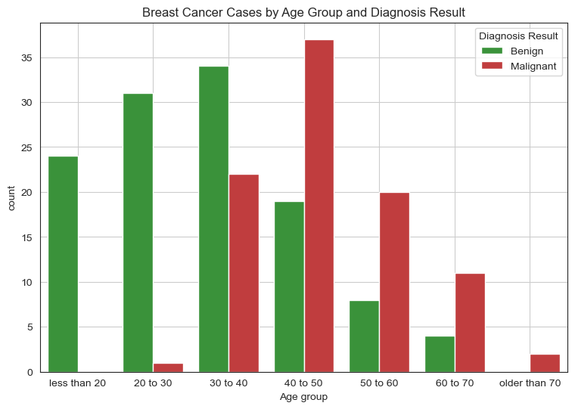
Age Groups Distribution of Breast Cancer Cases
Patients between ages 30 to 50 recorded the highest number of breast cancer cases.
Malignant cases were most common in the 40 to 50 age group with 37 recorded cases.
Benign cases were highest among patients aged 30 to 40 with 34 cases.
Malignant diagnoses increased noticeably with age, particularly from age 40 and above.
Very few malignant cases were recorded among patients below 30 years.

Slide 7
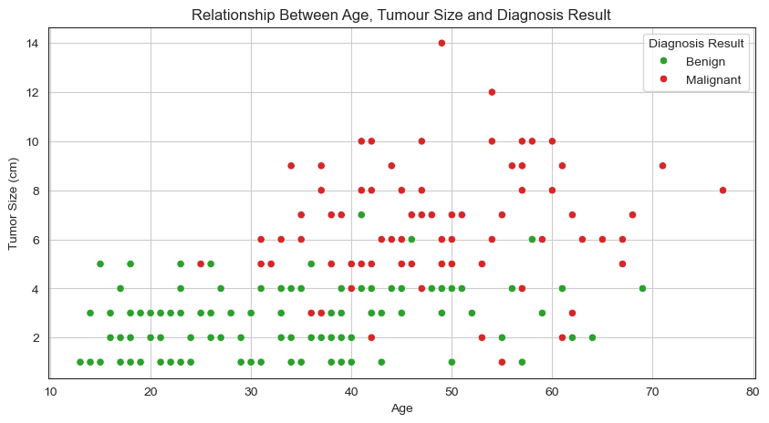
Relationship Between Tumor Size and Diagnosis Result
Malignant cases were generally associated with larger tumor sizes compared to benign cases.
Most benign cases were concentrated within smaller tumor sizes, mainly between 1cm and 5cm.
Larger tumor sizes above 6cm were more frequently linked to malignant diagnoses.
Malignant cases were more common among middle-aged and older patients.

Slide 8
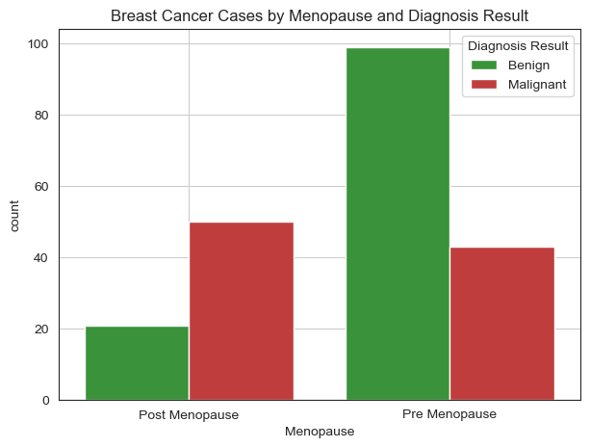
Impact of Menopause on Breast Cancer Diagnosis
Pre-menopausal patients recorded the highest number of benign cases with 99 cases.
Post-menopausal patients showed a higher number of malignant cases with 50 recorded cases.
Malignant diagnoses were more common among post-menopausal patients compared to benign diagnoses.
The results suggest a possible relationship between menopause status and breast cancer severity.

Slide 9
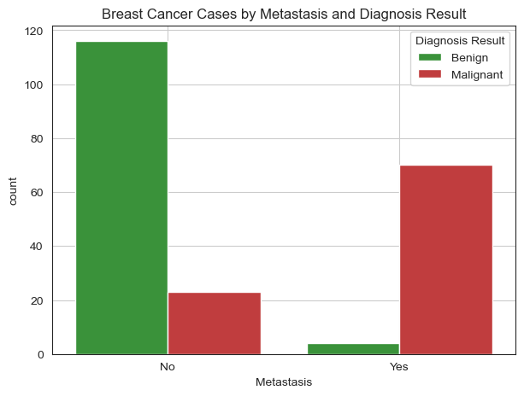
Relationship Between Metastasis and Diagnosis Severity
Most malignant cases were associated with metastasis, with 70 recorded cases.
Benign cases showed very low metastasis occurrence, with only 4 cases.
The majority of non-metastatic cases were benign diagnoses.
The results indicate a strong relationship between metastasis and malignant breast cancer diagnosis.

Slide 10
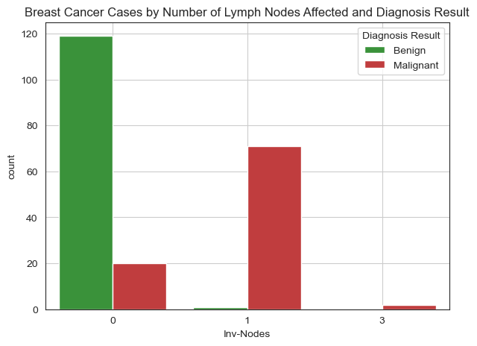
Relationship Between Involved Lymph Nodes and Diagnosis Result
Patients with zero involved lymph nodes were mostly benign cases with 119 recorded cases.
Malignant cases were strongly associated with involved lymph nodes, especially at level 1 with 71 cases.
Higher lymph node involvement showed a clear shift toward malignant diagnosis.
The results indicate lymph node involvement is a strong indicator of cancer severity

Slide 11
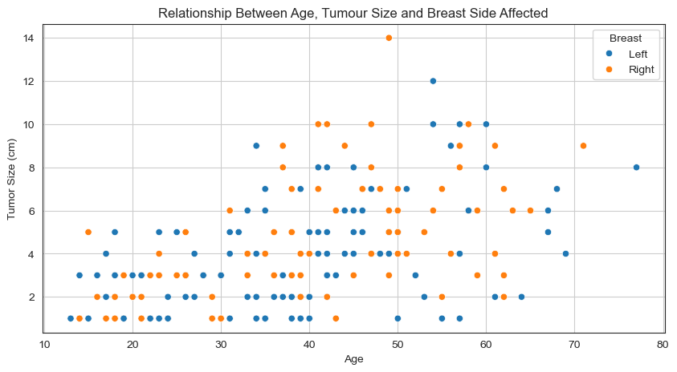
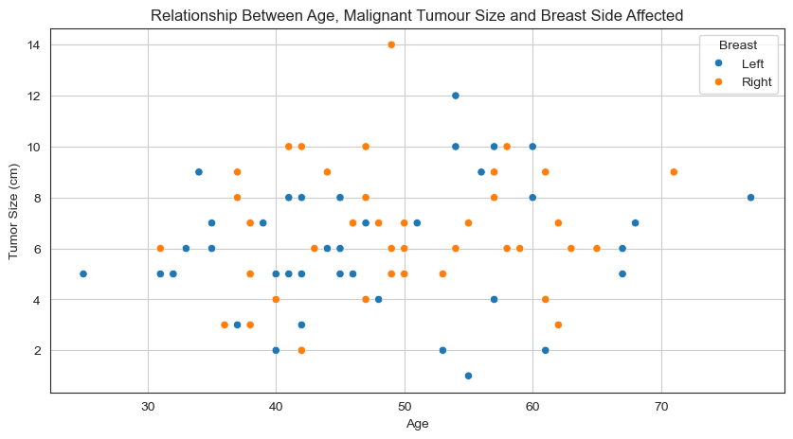
Distribution of Breast Cancer Cases by Breast Side
Breast cancer cases were evenly distributed between the left and right breast.
No significant difference was observed in the occurrence rate between both sides.
The results suggest breast side does not strongly influence diagnosis patterns in this dataset.

Slide 12
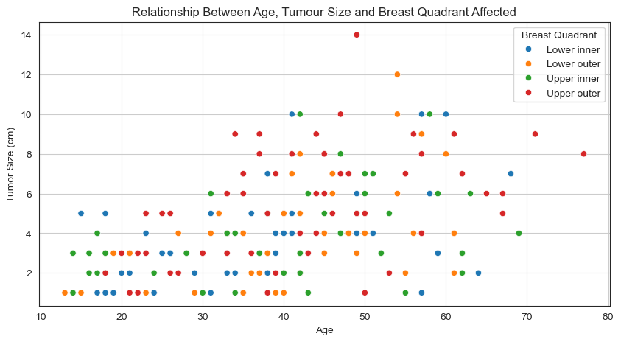
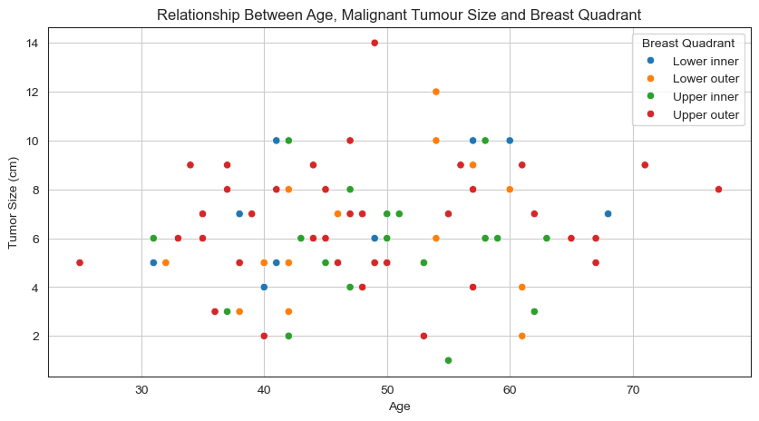
Distribution of Breast Cancer Cases Across Breast Quadrants
Breast cancer cases were evenly distributed between the left and right breast.
No significant difference was observed in the occurrence rate between both sides.
The results suggest breast side does not strongly influence diagnosis patterns in this dataset.

Slide 13
Medical Questions & Findings
1. What percentage of patients were diagnosed with malignant breast cancer?
Ans: Malignant cases make up a significant portion of the dataset but are slightly fewer than benign cases.
2. Which age group is most vulnerable?
Ans: Patients aged 40–50 are the most vulnerable group.
3. Did cancer cases increase in 2020?
Ans: Total cases slightly increased in 2020 compared to 2019.
4. Are larger tumors usually malignant?
Ans: Larger tumors are more commonly associated with malignant diagnoses.
5. Does menopause increase malignant diagnosis risk?
Ans: Post-menopausal patients show a higher occurrence of malignant cases.
6. How strongly is metastasis connected to malignancy?
Ans: Metastasis is strongly linked to malignant diagnosis.
7. Which breast quadrant is most commonly affected?
Ans: No specific breast quadrant is more commonly affected than others.
8. Are patients with medical history at greater risk?
Ans: Post-menopausal status appears to be associated with higher risk.
9. Can involved lymph nodes help predict severity?
Ans: Higher involved lymph nodes are strongly associated with malignant cases.
10. Which factors appear most associated with malignant diagnosis?
Ans: Menopause, Tumor size, metastasis, History and lymph node involvement are the strongest indicators of malignancy.

Slide 14
THANK YOU
Presented by
Ademola Abraham Data Analyst
Open to questions and further discussion

